Slide 1


Library management by c
C Language Project
Subject code:32
By:
VENCY PATEL, 6B,254,CE
DEVANSH MAJITHIA,6B,260,IT
NAMAN SHAH,6B,275,CE
VIRTI SHAH,6B,273,CE

Slide 2
INTRODUCTION
Library management system is a simple console application without graphics developed using C programming language
It is compiled in: Dev C++
This mini project utilizes various aspects of C language such as function, array, structure, switch, if-else
With these simple programme user can easily add book details, read book details, search a book with its subject name or book name or author name, update book details, and delete a book details.

Slide 3
Features
The key features of library management system are:
Add books
Display books
Update a book
Search a book
Delete a book

Slide 4
Language &Libraries Uses
C Language used
stdio.h
conio.h
string.h

Slide 5
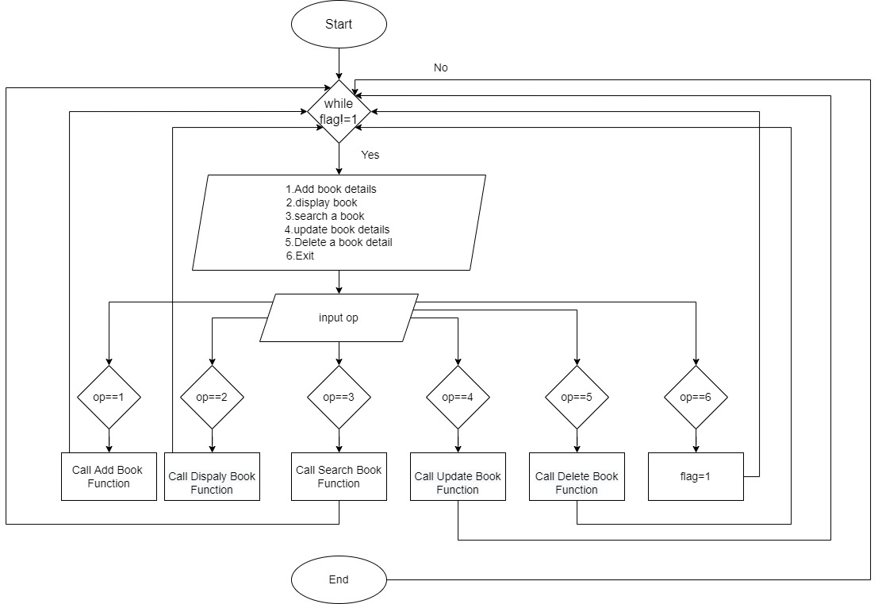
Flowchart

Slide 6
Thank you

